Slide 1
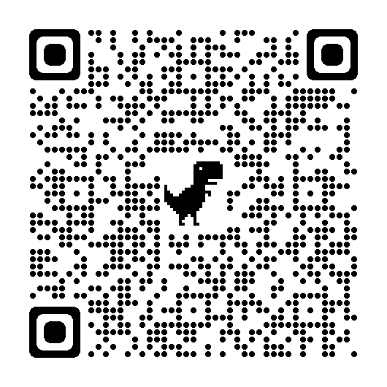
Spring 2022 Kickoff Meeting
Welcome back everyone!

Slide 2
Agenda
01
02
03
04
Meet the Eboard
Team Updates
Learn about the goals of each team
Point Opportunities
Upcoming Meetings/Events
Find out how you can be more active in our club and earn points doing it
Trust me, you wanna stick around for this

Slide 3
Mission Statement
—The OG InnoGators Eboard
“To create a space of innovation and collaboration by inviting culturally diverse minds and talents to influence the engineering design experience.”

Slide 4
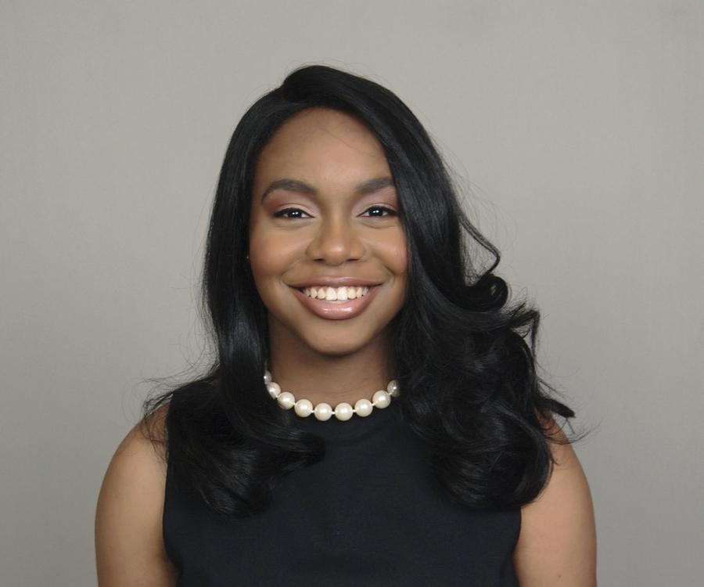
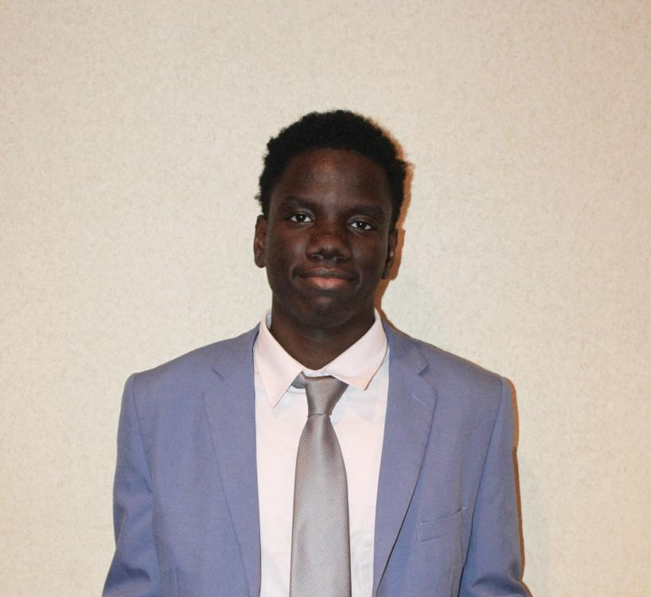
Shoutouts!
Morgan Cobb
2022 Explore Intern
Rudolph Civil
Software Engineering Intern
Lily Monaghan
2022 Summer Intern

Slide 5
Meet the Eboard
We’re cool people

Slide 6
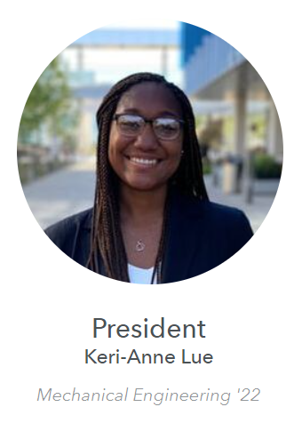
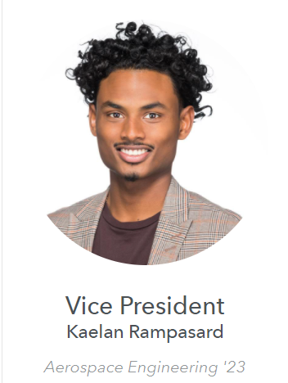
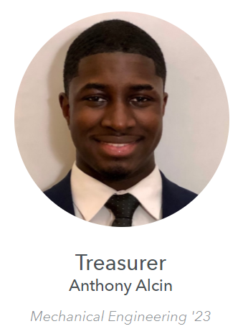
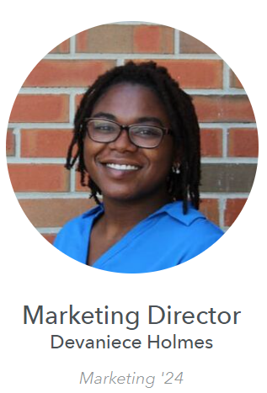
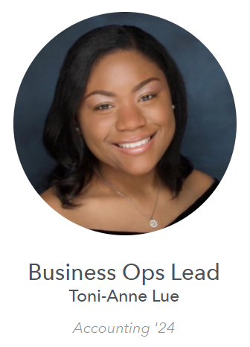
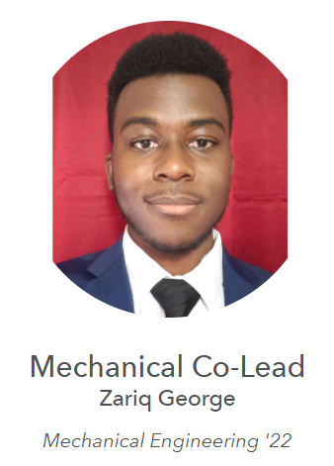
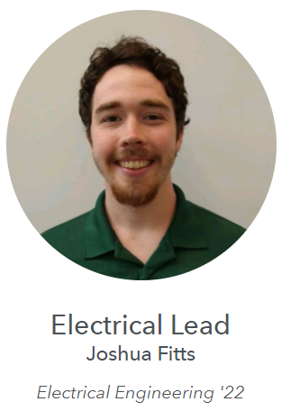
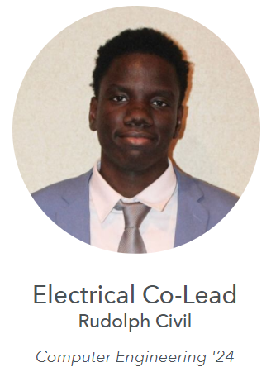
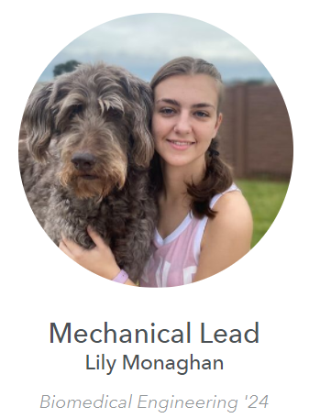
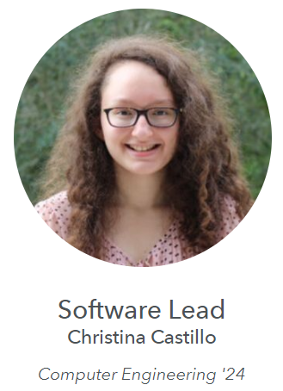
2021-2022 Eboard Members

Slide 7
Team Updates
Stay tuned

Slide 8
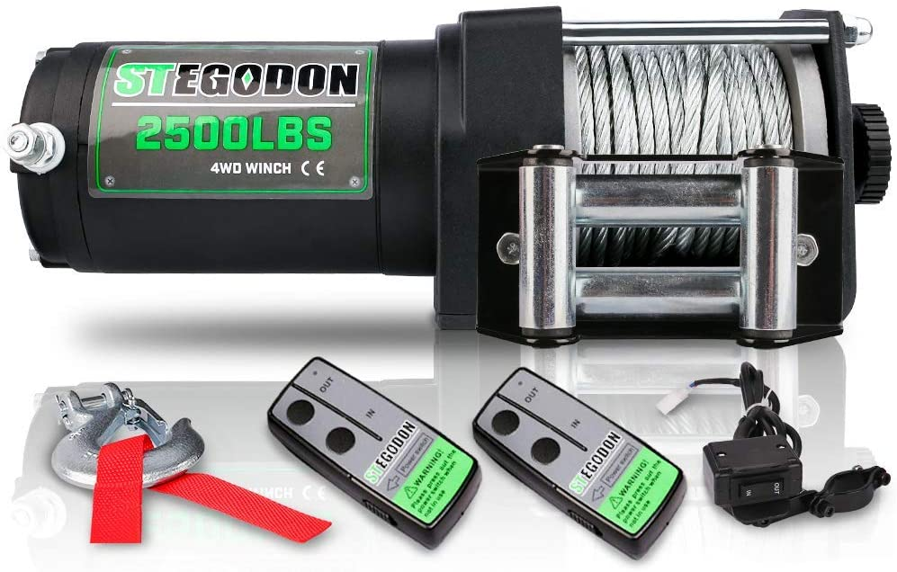
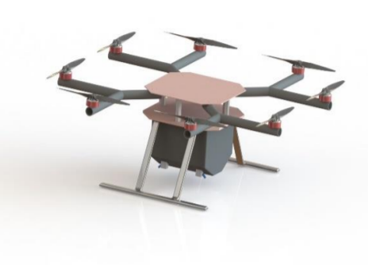
Mechanical Team
Shredder
Drone
New motor is in.
Coupler to be made.
Get it in motion for analysis.
Generate a preliminary design for “customer” review

Slide 9
Electrical Team
Shredder
Drone
Documentation and block diagrams each week
Incorporate new winch
Lighting system/emergency stop
Documentation/block diagrams for the system
Assemble and test new components

Slide 10
Software Team
Main Project
Side Project
Drone will start coming to meetings more regularly this semester
Raspberry Pi’s got delivered for us to use soon
Get more familiar with them to use them for the drone
There’s new C++ example project code to show
Hopefully you can learn something from it :)

Slide 11
Business Operations Team
Buttons Day
Submit SAR
Find Polos in Bulk
-Arts and Crafts Center
- 50 buttons
-Food for upcoming workshops
-ASAP!
-Minimum of 11 polos

Slide 12
Point Opportunity!
E-fair 2022

Slide 13
What is E-fair?
Purpose
Location
Date and Time
To bring different fields of engineering together to educate k-12 students about engineering. We hope to inspire interest and passion for STEM early on in students' lives
Reitz Union
February 22-23 from
9 am -2 pm
We participate from 12:20 pm - 1:20 pm

Slide 14
Point Opportunity!
E-fair 2022
3
2
3
2
Be a Volunteer!
Help set up our table!
Act as a tour guide to get student groups to the correct location
Kinda self explanatory….
Help record our video submission!
Table with us!
It will be a 6-12 min video introducing the design team and our current projects
Come and help elementary, middle, and high school students get excited about engineering!

Slide 15
Activity | Points
Attend a General Meeting | 2
Attend a Design Meeting | 2
Invite a friend to a meeting | 1
Table with us | 2
Present at another club meeting | 4
Attend a social | 1
Attend a workshop | 3
Point System!
Level | Requirements | Benefits
Member of the Semester | Acquired the most points; Attended at least two events | Google Home; free t-shirt; gift card; 3D print something of your choice
Gold | Attended at least 9 meetings; Attended at least two events | Free t-shirt; gift card; 3D print something of your choice
Silver | Attended at least 8 meetings; Attended at least one event | Gift card; 3D print something of your choice
Bronze | Attended at least 5 meetings | 3D print something of your choice

Slide 16
Upcoming Meetings and Events
Really cool things

Slide 17
Speaker Series: Corporate Edition
With Andre Sotomayor
Date: Next Tuesday, January 18
Time: 5:00 PM
Location: TBD

Slide 18
Create with Power Apps!
Date: Tuesday, January 25
Time: 6:15 PM
Location: Rhines 125

Slide 19
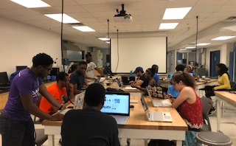
Design Meeting
Date: Thursday, January 20
Time: 6:15 PM
Location: Rhines B06

Slide 20
Meeting Schedule
Tuesdays
Thursdays
Update Meetings/ Workshops
Time: Typically at 6:15 PM
Location: Rhines 125
Design Meetings
Time: 6:15 PM
Location: Rhines B06

Slide 21
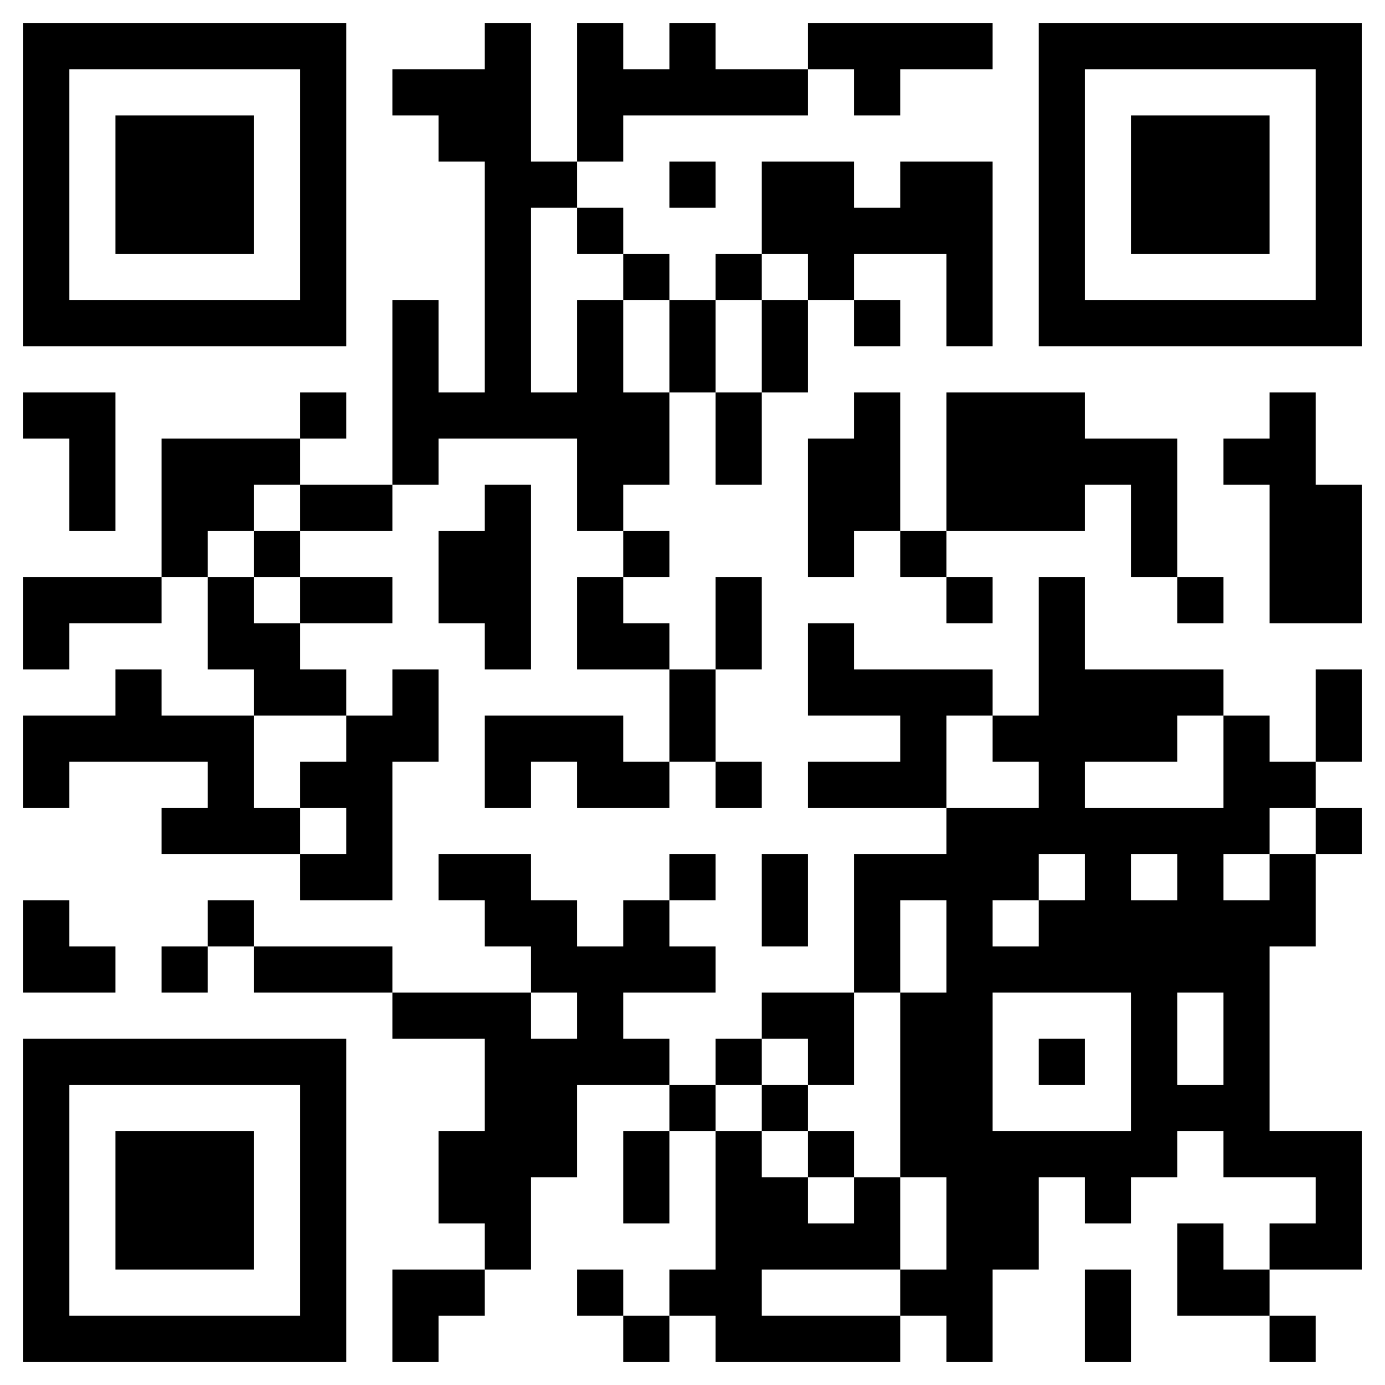
Join our Workspace in Slack!

Slide 22
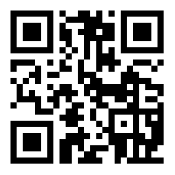
Visit our website! It’s Cool!

Slide 23
Connect with Us!!
President - Keri-Anne Lue
president.innogators@gmail.com
Vice President - Kaelan Rampasard
vp.innogators@gmail.com
Treasurer - Anthony Alcin
treasurer.innogators@gmail.com
Business Ops Lead - Toni-Anne Lue
operationslead.innogators@gmail.com
Marketing Director - Devaniece Holmes
secretary.innogators@gmail.com
Mechanical Lead - Lily Monaghan
mechanical.innogators@gmail.com
Mechanical Co-Lead - Zariq George
mechcolead.innogators@gmail.com mechcolead.innogators@gmail.com
Electrical Lead - Joshua Fitts
electrical.innogators@gmail.com
Software Lead - Christina Castillo
​software.innogators@gmail.com
Software Co-Lead - Morgan Cobb
​softwarecolead.innogators@gmail.com
- innogators.weebly.com
- @innogators
- InnoGators

